Slide 1
Making a Native American Flute
The "Morning" section of this piece is played on a Ken Light five-hole cedar courting flute reproduction. The "Evening" section is played on a Ken Light six-hole D# large-bore Native American-style cedar flute.

Slide 2
Timeline…
Week 1
Basic Anatomy of the Native American Flute (NAF)
Getting your flute to “speak”
Determining the basic acoustic parameters for your flute
Introduction to “Flutomat” and “Flutopaedia”
Week 2
Choosing the key for your flute
Voicing your flute

Slide 3
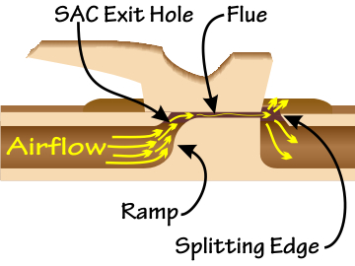
Anatomy of the NAF
Bird or Fetish

Slide 4
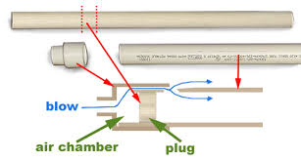
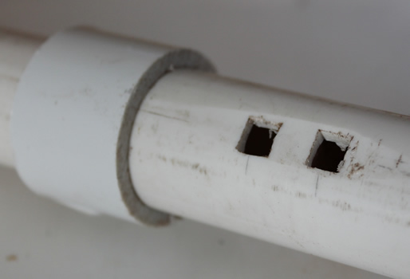
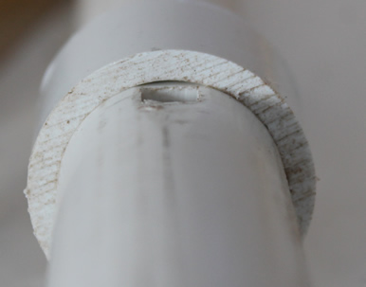
The PVC – NAF!
Main Tasks:
Cutting corkplug and fitting between SAC and SC
Shaping the splitting edge (or fipple)
Shaping the “ramp”
For what follows please write up a detailed “diary” of what you are doing – this will be handed in as an assignment when you are finished.

Slide 5
End corrections K1 & k2
When you get your flute to speak you will need to measure the frequency of the fundamental*
Use either interface/FFT or tuner to do this
Calculate the Acoustic Length
*this is not the final “fundamental” – you will need to cut the tube to establish the key of your flute. We will do this later.

Slide 6
Preliminary Analysis of Your Flute
Prepare a FFT
Judge tone quality (by ear) and note if overtone is problematic (does it “jump the octave”, squeak, etc?)
Sand, shape, smooth etc until you can produce a clear, sustained fundamental note
Compare FFT before and after as well as noting differences in what you hear

